Slide 1


Digital Circuits
Introductory Concepts

Slide 2
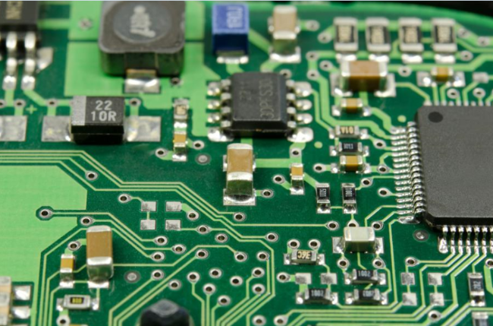
Introduction
The term digital is derived from the way operations are performed
Digital = signals = expressed as series of the digits 0 and 1 = values of a physical quantity such as voltage or magnetic polarization.

Slide 3
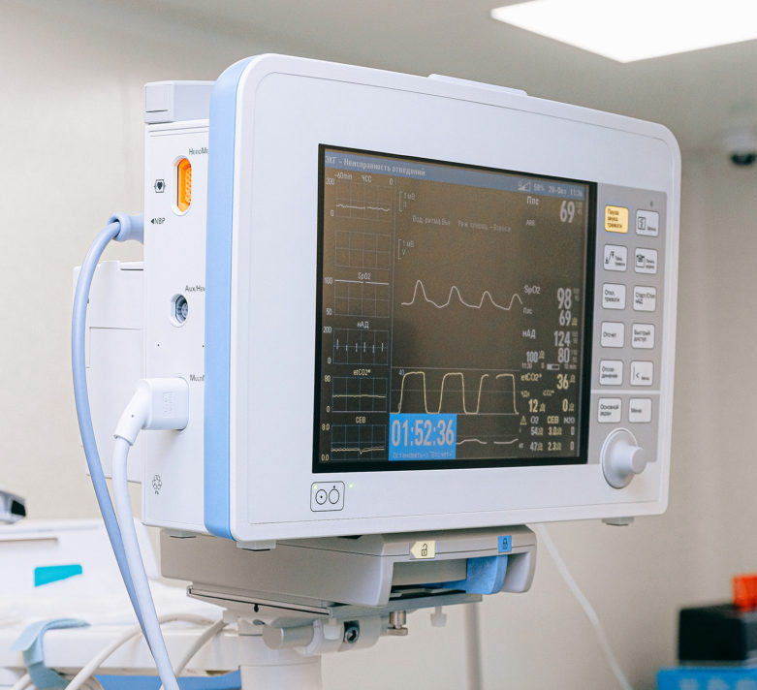
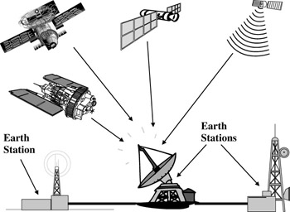
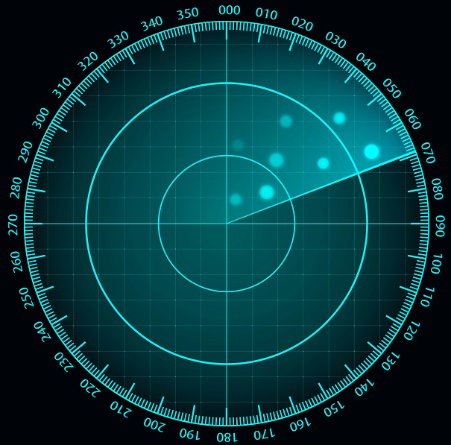
Introduction
Digital technology applied in a wide range of areas
Computers, television,
communications systems,
radar,
navigation and guidance systems,
military systems,
medical instrumentation,
industrial process control,
consumer electronics

Slide 4
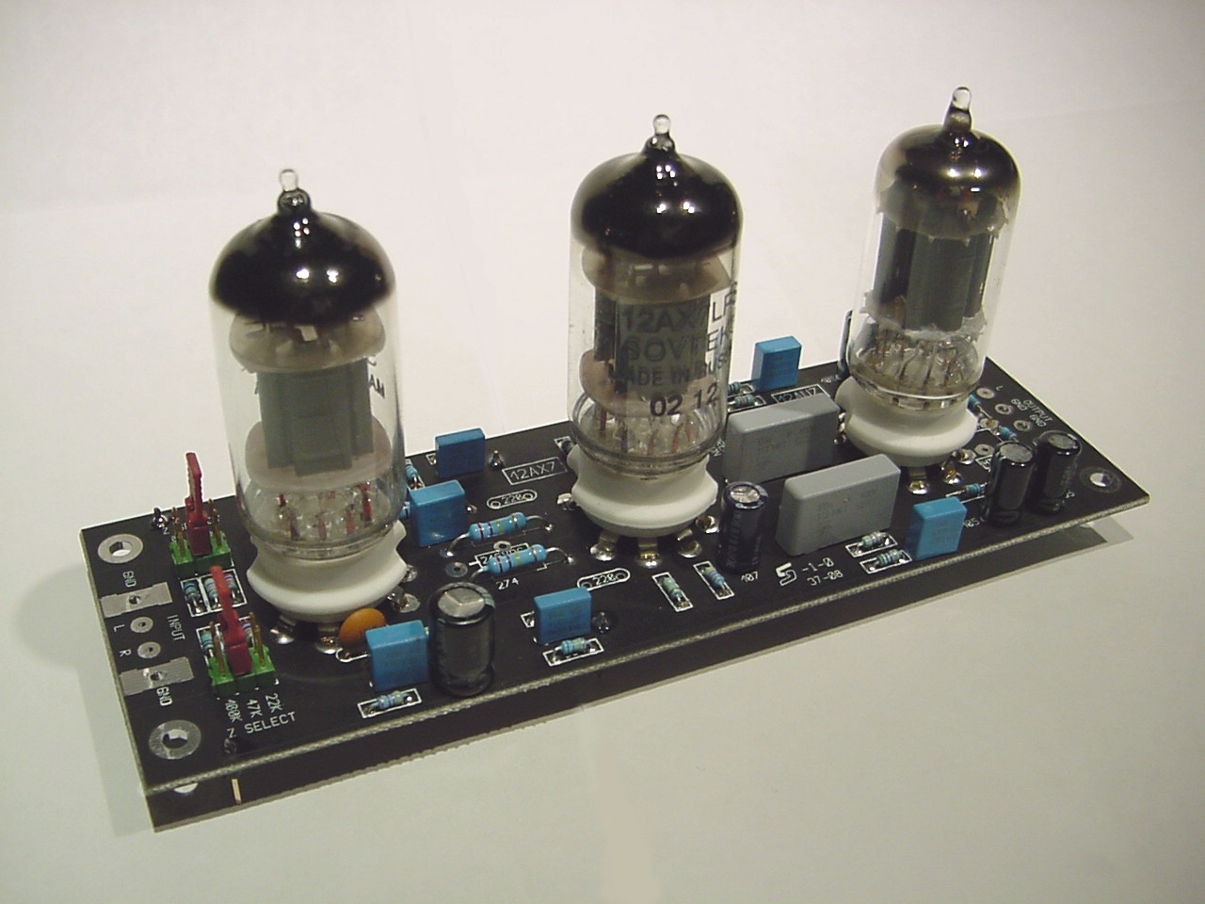
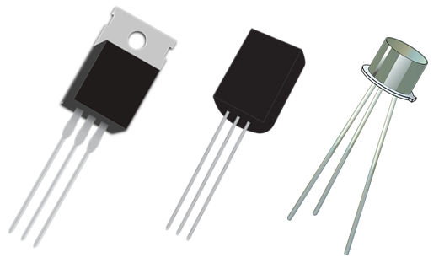
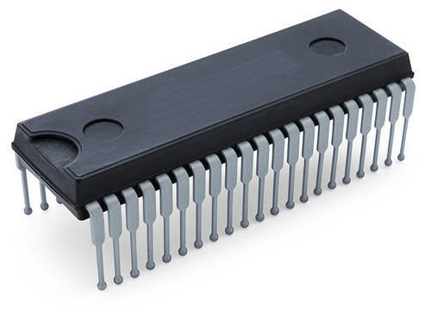
Introduction
vacuum-tube circuits
discrete transistors
complex integrated circuits

Slide 5
Section Outline
Digital and Analog Quantities
Binary Digits, Logic Levels, and Digital Waveforms
Basic Logic Functions

Slide 6
Digital and Analog Quantities
Electronic circuits
Digital
Analog

Slide 7
Digital and Analog Quantities
Electronic circuits
Digital
Analog
Digital electronics involves quantities with discrete values.
Analog electronics involves quantities with continuous values.

Slide 8
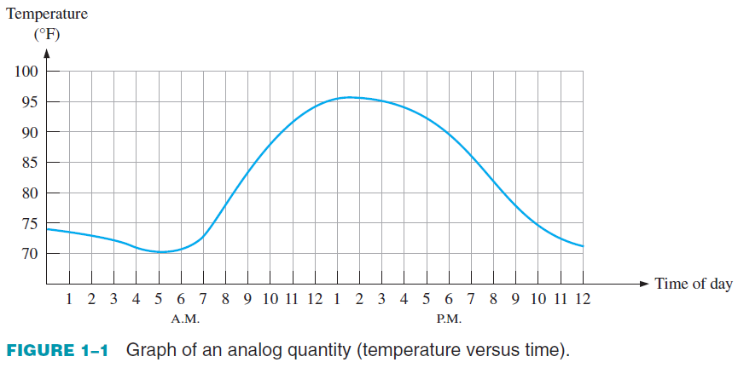
Digital and Analog Quantities
Most things occur in nature can be measured quantitatively in analogue form.
air temperature, time, pressure, sound, electricity.

Slide 9
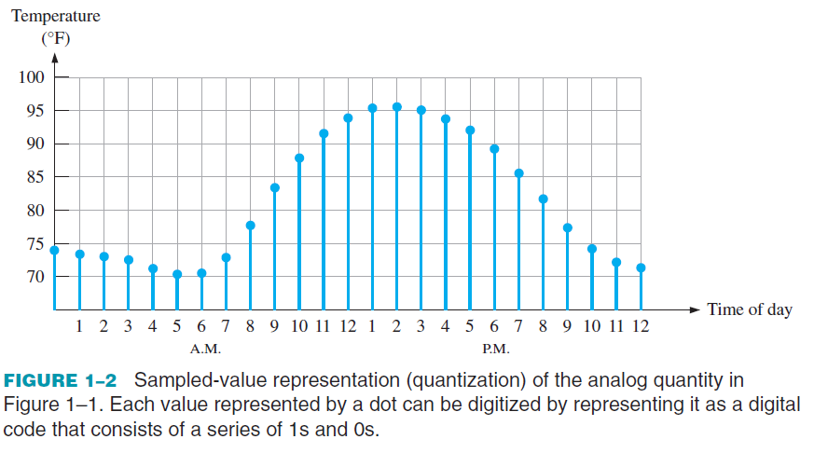
Digital and Analog Quantities
Rather than graphing measurements continuously, sample the values at discrete points of time.
E.g., Capture measurements every hour

Slide 10
Digital and Analog Quantities

Slide 11
Digital and Analog Quantities
Digital representation has advantages over analog representation
Reliable data transfer and processing.
Data storage.
Noise removal.
Example, music when converted to digital form can be stored more compactly and reproduced with greater accuracy and clarity than is possible when it is in analog form.

Slide 12
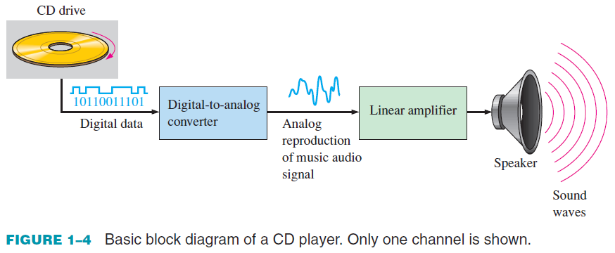
Digital and Analog Quantities
The CD player uses digital and analog circuits.
Music in digital form is stored on the compact disk.
A laser diode reads digital data and transfers it to digital-to-analog-converter.
The DAC changes the digital data into an analog signal.
Signal is amplified and sent to the speaker

Slide 13
Checkup
Define analog.
Define digital.
Give an example of a system that is analog and one that is a combination of both digital and analog.
Name a system that is entirely digital.

Slide 14
Quiz
What IC means?
Mention the main ICs found in your computer’s motherboard.

Slide 15
Section Outline
Digital and Analog Quantities
Number Systems
Basic Logic Functions

Slide 16
Number Systems
Digital electronics involves circuits and systems in which there are only two possible states.
HIGH, (+5V, Pulse)
LOW. (0 V, No pulse)
Combinations of the two states are used to represent numbers, symbols, alphabetic characters, and other types of information.
The two-state number system is called binary
Two digits only, 0 and 1.
A binary digit is called a bit.

Slide 17
Number Systems
Number System
Decimal
Binary
Octal
Hexadecimal

Slide 18
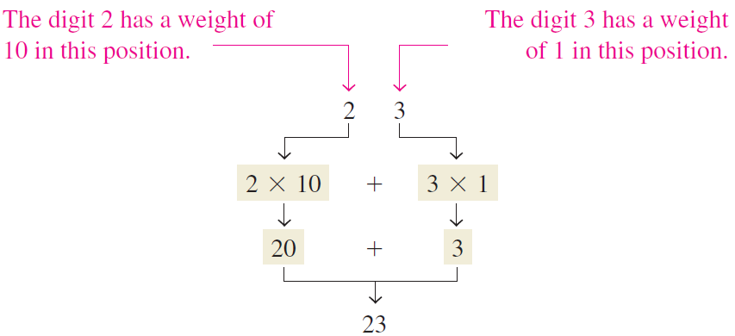
Number Systems: Decimal
In the decimal number system, we have ten digits, 0 through 9.
The position of a digit representants the magnitude of a quantity.

Slide 19

Number Systems: Decimal
The weights for whole numbers are positive powers of ten that increase from right to left, beginning with ${10}^{0} = 1$.
${10}^{3}, {10}^{2}, {10}^{1}, {10}^{0}$
For fractional numbers, the weights are negative powers of ten that decrease from left to right beginning with ${10}^{−1}$.
${10}^{2} {10}^{1} {10}^{0}.{10}^{−1} {10}^{−2} {10}^{−3}$

Slide 20
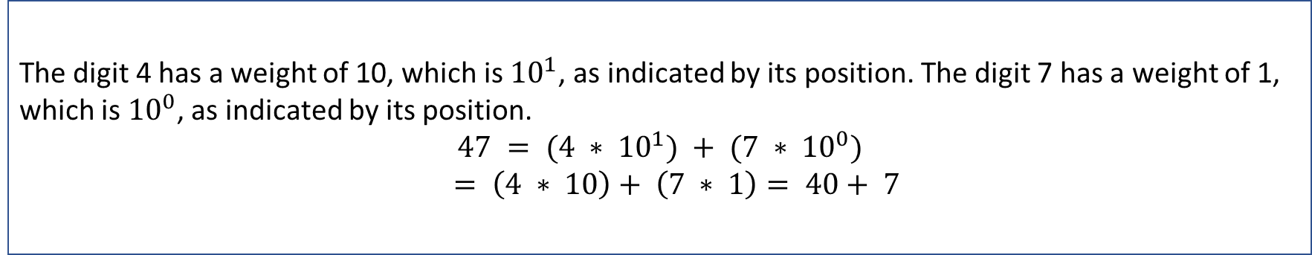
Number Systems: Decimal
The value of a decimal number is the sum of the digits after each digit has been multiplied by its weight.
Example
Express the decimal number 47 as a sum of the values of each digit.
Solution
The digit 4 has a weight of 10, which is ${10}^{1}$, as indicated by its position. The digit 7 has a weight of 1, which is ${10}^{0}$, as indicated by its position.
$$47 = (4 ∗ {10}^{1}) + (7 ∗ {10}^{0})$$
$$= \left(4 ∗ 10\right)+ \left(7 ∗ 1\right)= 40+ 7$$

Slide 21
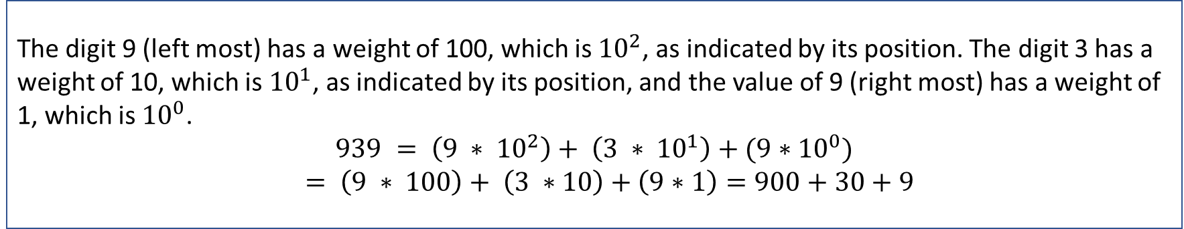
Checkup
Determine the value of each digit in 939.
Solution
The digit 9 (left most) has a weight of 100, which is ${10}^{2}$, as indicated by its position. The digit 3 has a weight of 10, which is ${10}^{1}$, as indicated by its position, and the value of 9 (right most) has a weight of 1, which is ${10}^{0}$.
$$939 = \left(9 ∗ {10}^{2}\right)+ \left(3 ∗ {10}^{1}\right)+(9∗{10}^{0})$$
$$= \left(9 ∗ 100\right)+ \left(3 ∗10\right)+\left(9∗1\right)=900+30+9$$

Slide 22
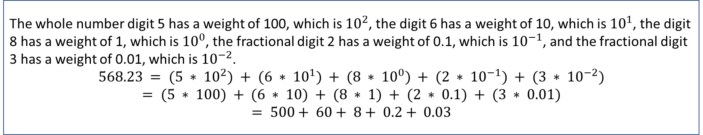
Number Systems: Decimal
The value of a decimal number is the sum of the digits after each digit has been multiplied by its weight.
Example
Express the decimal number 568.23 as a sum of the values of each digit.
Solution
The whole number digit 5 has a weight of 100, which is ${10}^{2}$, the digit 6 has a weight of 10, which is ${10}^{1}$, the digit 8 has a weight of 1, which is ${10}^{0}$, the fractional digit 2 has a weight of 0.1, which is ${10}^{−1}$, and the fractional digit 3 has a weight of 0.01, which is ${10}^{−2}$.
$$568.23 = (5 ∗ {10}^{2}) + (6 ∗ {10}^{1}) + (8 ∗ {10}^{0}) + (2 ∗ {10}^{−1}) + (3 ∗ {10}^{−2})$$
$$= (5 ∗ 100) + (6 ∗ 10) + (8 ∗ 1) + (2 ∗ 0.1) + (3 ∗ 0.01)$$
$$= 500+ 60+ 8+ 0.2+ 0.03$$

Slide 23
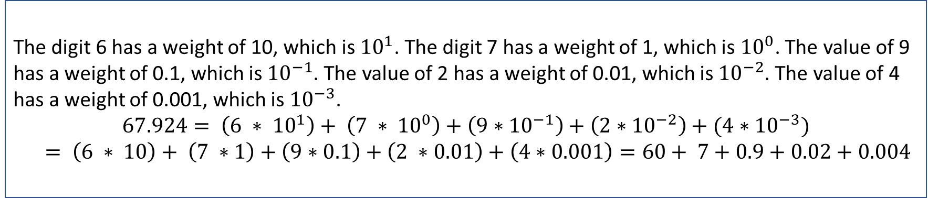
Checkup
Determine the value of each digit in 67.924.
Solution
The digit 6 has a weight of 10, which is ${10}^{1}$. The digit 7 has a weight of 1, which is ${10}^{0}$. The value of 9 has a weight of 0.1, which is ${10}^{−1}$. The value of 2 has a weight of 0.01, which is ${10}^{−2}$. The value of 4 has a weight of 0.001, which is ${10}^{−3}$.
$$67.924= \left(6 ∗ {10}^{1}\right)+ \left(7 ∗ {10}^{0}\right)+\left(9∗{10}^{−1}\right)+\left(2∗{10}^{−2}\right)+(4∗{10}^{−3})$$
$$= \left(6 ∗ 10\right)+ \left(7 ∗1\right)+\left(9∗0.1\right)+\left(2 ∗0.01\right)+\left(4∗0.001\right)=60+ 7+0.9+0.02+0.004$$

Slide 24
Number Systems
Number System
Decimal
Binary
Octal
Hexadecimal

Slide 25

Number Systems: Binary
Binary system less complicated than the decimal system.
Binary system has two digits, 0 and 1 (base 2).
Decimal system has nine digits, 0 to 9 (base 10).
The position of a 1 or 0 in a binary number indicates its weight.
The weights in a binary number are based on powers of two. ($2^{0}, 2^{1}, 2^{2}, …$)

Slide 26
Number Systems: Binary
To count in decimal system, we start with 0 and continue to 9.
To count more, we start another digit position. (0:9, 10:99, 100:999, ….)
To count in binary system, we start with 0 and continue to 1 ONLY.
To count more, we start another digit position. (0:1, 10:11, 100:111, …..)

Slide 27
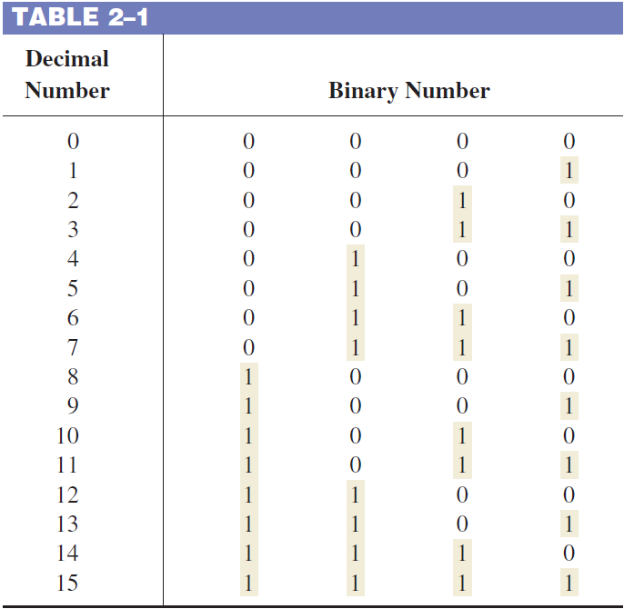

Number Systems: Binary
With n bits you can count up to a number equal to $2^{n} − 1$.
Four bits are required to count from zero to 15.
With five bits (n = 5) you can count from zero to thirty-one. ${ 2}^{5} − 1 = 32 − 1 = 31$
With six bits (n = 6) you can count from zero to sixty-three.
$2^{6} − 1 = 64 − 1 = 63$

Slide 28

Number Systems: Binary
A binary number is a weighted number.
The right-most bit is the LSB (least significant bit) = $2^{0}$
The weights increase from right to left by a power of two for each bit.
The left-most bit is the MSB (most significant bit) = $2^{n−1}$
Fractional numbers can be represented in binary by placing bits to the right of the binary point. $2^{n-1} …2^{3} 2^{2} 2^{1} 2^{0} . 2^{-1} 2^{-2}2^{−3} …2^{-n}$

Slide 29
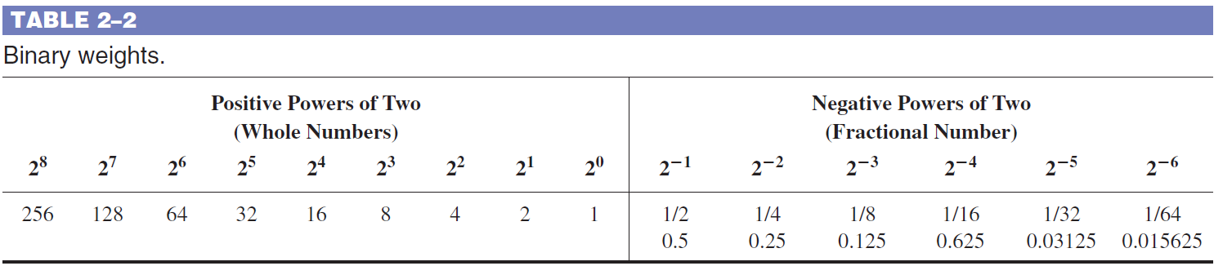
Number Systems: Binary
The powers of two and their equivalent decimal weights for an 8-bit binary whole number and a 6-bit binary fractional number are shown in Table 2–2.

Slide 30
Check-up
What is the largest decimal number that can be represented in binary with eight bits?
Determine the weight of the 1 in the binary number 10000.
Count students in binary.

Slide 31
Number Systems
Number System
Decimal
Binary
Octal
Hexadecimal

Slide 32

Number systems: Octal
The octal number system is composed of eight digits
0, 1, 2, 3, 4, 5, 6, 7
To count above 7, begin another column and start over:
10, 11, 12, 13, 14, 15, 16, 17, 20, 21, …
Counting in octal is like counting in decimal, except that the digits 8 and 9 are not used.
Subscripts to distinguish decimal from octal
Octal numbers use subscript 8 or O, i.e., ${\left(15\right)}_{8}$ or ${\left(15\right)}_{O}$
Decimal numbers use subscript 10 or D, i.e., ${\left(15\right)}_{10}$ or ${\left(15\right)}_{D}$

Slide 33
Number Systems
Number System
Decimal
Binary
Octal
Hexadecimal

Slide 34
Number systems: Hexadecimal
The hexadecimal number system has sixteen characters.
Hexadecimal is widely used in computer and microprocessor applications.
0, 1, 3, 4, 5, 6, 7, 8, 9, A, B, C, D, E, F
Digital systems process binary data in groups that are multiples of four bits.
Each hexadecimal digit represents a 4-bit binary number.

Slide 35
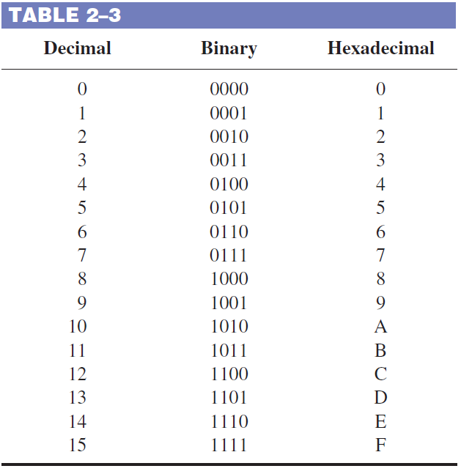

Number systems: Hexadecimal
Each hexadecimal digit represents a 4-bit binary number.
Counting with hex:
Start with 0 through F
Then add new digit to the left and start again
E.g., 0, 1, 2, …, E ,F, 10, 11, 12, 13, …, 1E, 1F.
Hex numbers use subscript H or 16.
${\left(11\right)}_{H}$ or ${\left(11\right)}_{16}$

Slide 36
Section Outline
Digital and Analog Quantities
Number Systems
Basic Logic Functions

Slide 37
Basic Logic Functions
In its basic form, logic is the realm of human reasoning that output a result depending on a condition.
ONLY True and False == 1 and 0
The term logic is applied to digital circuits used to implement logic functions.
Digital logic circuits are the basic elements that form the building blocks for such complex digital systems as the computer.

Slide 38
Basic Logic Functions
Logic functions
AND
OR
NOT

Slide 39
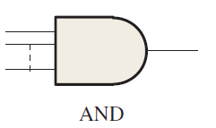
Basic Logic Functions: AND
The AND function produces a HIGH output only when all the inputs are HIGH.
If all input is +5V (1, True, Yes), the AND function outputs +5V (1, True, Yes)
It outputs 0V (0, False, No) otherwise.

Slide 40
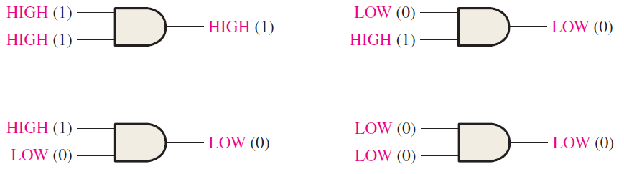
Basic Logic Functions: AND
X | Y | AND
0 | 0 | 0
0 | 1 | 0
1 | 0 | 0
1 | 1 | 1

Slide 41
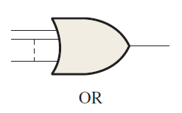
Basic Logic Functions: OR
The OR function produces a HIGH output when one or more inputs are HIGH
If one of the input (or both) is +5V (1, True, Yes), the OR function outputs +5V (1, True, Yes)
It outputs 0V (0, False, No) if all inputs are 0V (0, False, No).

Slide 42
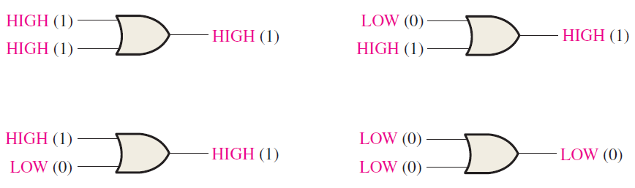
Basic Logic Functions: AND
X | Y | OR
0 | 0 | 0
0 | 1 | 1
1 | 0 | 1
1 | 1 | 1

Slide 43
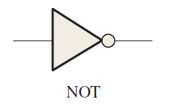
Basic Logic Functions: NOT
The NOT function changes one logic level to the opposite logic level.
If input is 0V (0, False, No), the output is +5V (1, True, Yes)
If input is +5V (1, True, Yes), the output is 0V ( 0, False, No)

Slide 44

Basic Logic Functions: AND
X | NOT
0 | 1
1 | 0

Slide 45
Summary
Explain the basic differences between digital and analog quantities.
Explain the basic logic functions of NOT, AND, and OR.
Review the decimal number system.
Define Binary system.
Define Hexadecimal system.
Define Octal system.

